Slide 1
Roku & Concept Nyx
Sandeep Vijayasarathy

Slide 2
















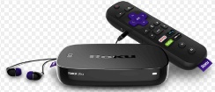





Roku Ecosystem Overview
ROKU Backend Ecosystem
Content Hosting
Features
ROKU Frontend Ecosystem
Content Providers
ROKU Channel
Developer Tools
Software and Devices
Direct Publisher
Content Engagement
Custom Publisher
Monetization
Channel Feed (Metadata)
Analytics & Reporting
Stream
Security
Definitions
Content hosting
OVP – Online Video Platform
CDN – Content Deliver Network
RSS – Really Simple Syndication
Vimeo – Video Platform
Metadata
Title
Descriptions
Keywords/Categories
Artwork
URLs to indicate where the media will be downloaded from
Publisher Type
Direct – No development needed. No coding required.
Custom – Development needed. Coding knowledge required.
Software & Devices
ROKU OS – Operating system installed on selected TV brands. No device needed
ROKU Players – Audio and Video players to plug and play with existing TVs. OS installed on streaming device.
Links
ROKU TV
Streaming Players
ROKU Audio
ROKU Developer Platform

Slide 3



Roku Provides Low-Cost, Smart OS to TV OEMs
Low-cost smart features via Roku OS
ROKU OS Highlights
Free License
No additional money required to license ROKU OS. TV OEMs can integrate into their Smart TVs for no cost.
TV OEMs
Monetize
Commission
ROKU OS is free to license and use, however ROKU gets a small commission whenever a ROKU based TV is sold.
Scale & Reach to millions of viewers
Economy of Scale
Reduces the cost significantly since TV OEMs will not have to develop and maintain Software making it competitive in the market.

Slide 4
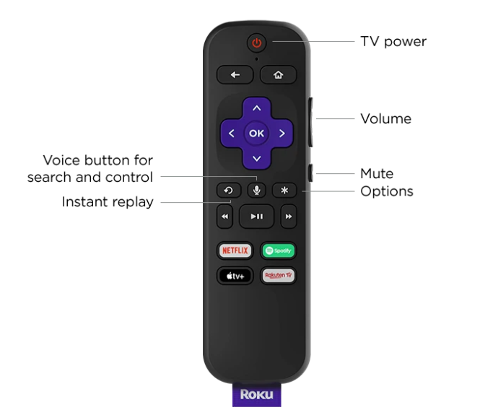
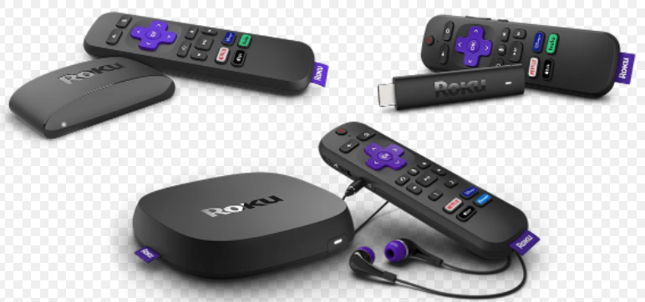
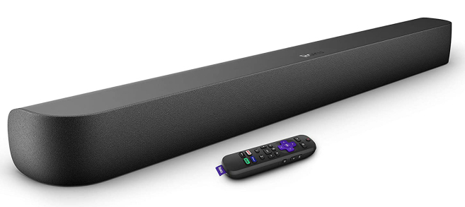
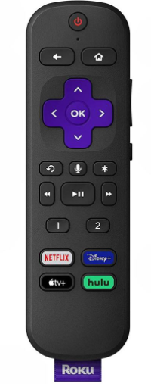
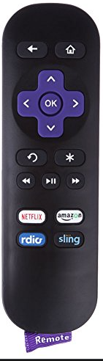
Roku earns money from Six different sources
Dynamic, Targeted Ads
Hardware
Short Ads
Targeted Ads
Dynamic Ads
Display Ads about 15s, 30s and more on Ad supported Channels
Target Ads based on Users’ Viewing habits, (Streaming, Linear TV), TV features, etc.
Replace traditional TV ads with Roku One Platform Ads
ROKU plug and play devices such as ROKU Ultra, ROKU Express, ROKU Streambar, ROKU Voice Remote etc.
Subscriptions
Roku Channel
Ad-Based Video on Demand (AVOD) enables ROKU to monetize its content with Ads.
A percentage of fee paid to ROKU when users subscribe to premium Streaming service

Slide 5













Concept Nyx enables more than gaming across form factors
Concept Nyx
Dell AlienWare
Bedroom
Dining Room
Internet
AR/ VR
Stream
Low Latency
Laptop
PC
High Response
Edge Processing
Cloud Gaming Service Providers
TV
Mobile
Study Room
Living Room
Concept Nyx Highlights
Stream Games using LAN
Process high performance games using Edge Processing at home and then share it across multiple devices in the house using local network (LAN).
Stream Up to 4 Games in Parallel
Power four game streams simultaneously and smartly switch among devices using App.
Central Library of Games
Display all the games purchased and subscriptions owned no matter where it is purchased from.

